Slide 1

ITMI
Started: 2010 (2011)
Overall goal: research on the integration of genomic information into the practice of medicine
80 FTEs, ~1/3 Clinical, 1/3 IT/Informatics, 1/3 Lab technical

Slide 2

Longitudinal Cohort Study (2012)
WGS + ‘omics + clinical data on up to 10,000 trio-based families.
Longitudinal study (prenatal-18 yrs).
Consented during pregnancy
Blood, saliva, urine, cord blood, placenta.
WGS + ‘omics + clinical data.

Slide 3







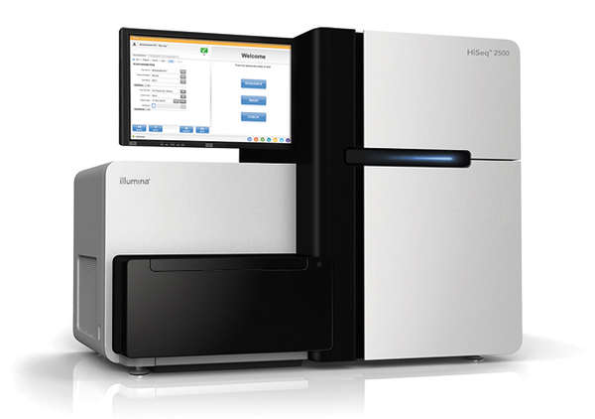
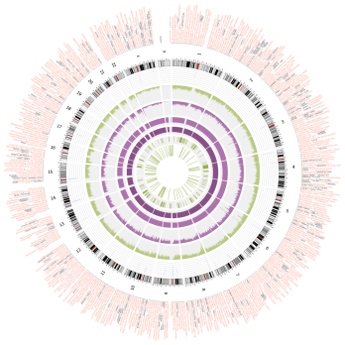

Longitudinal Pediatric Cohort Study Design
Family Enrollment
(Triad-based
Enrollment)
Sample Collection
(Prenatal and Delivery)
Data Analysis
Return of Results
Health and Medical history
Data
Longitudinal Follow-up (Survey, clinical)
Genetic (WGS, RNA Seq) and Epigenetic (Methylation, miRNA)

Slide 4
Clinical Workflow (Longitudinal)
12 weeks
2nd trimester – Mother/Family screened/enrolled in study, approached in OB clinics
26 weeks
Initial maternal prenatal samples w/ prenatal labs; paternal sample collected separately
delivery
Post delivery samples (e.g., maternal blood, saliva and urine, cord blood, placenta)
4-6 weeks
All outpatient and inpatient data automatically abstracted through EHR
3 yrs
Additional survey data collected at set 6 month intervals
Future
Opportunity to gather 1 year and 2 year blood samples in ~ 30% of population
Future
Opportunity to gather stool sample and microbiome samples
Future
Opportunity to gather hair, teeth, nails as well as EMR data
1-3 DOL
Infant samples (w/ NBS); (blood saliva, urine)

Slide 5
Clinical Information (Longitudinal)
All in/outpatient records captured through a single system-wide EMR (80% coverage)
Additional study-specific surveys (web-based):
Demographics (including ancestry-based)
Diet & nutrition
Growth & development- milestones
Overall health- screening tools
Specific health diagnoses
Multiple metrics of family psychosocial evaluation

Slide 6
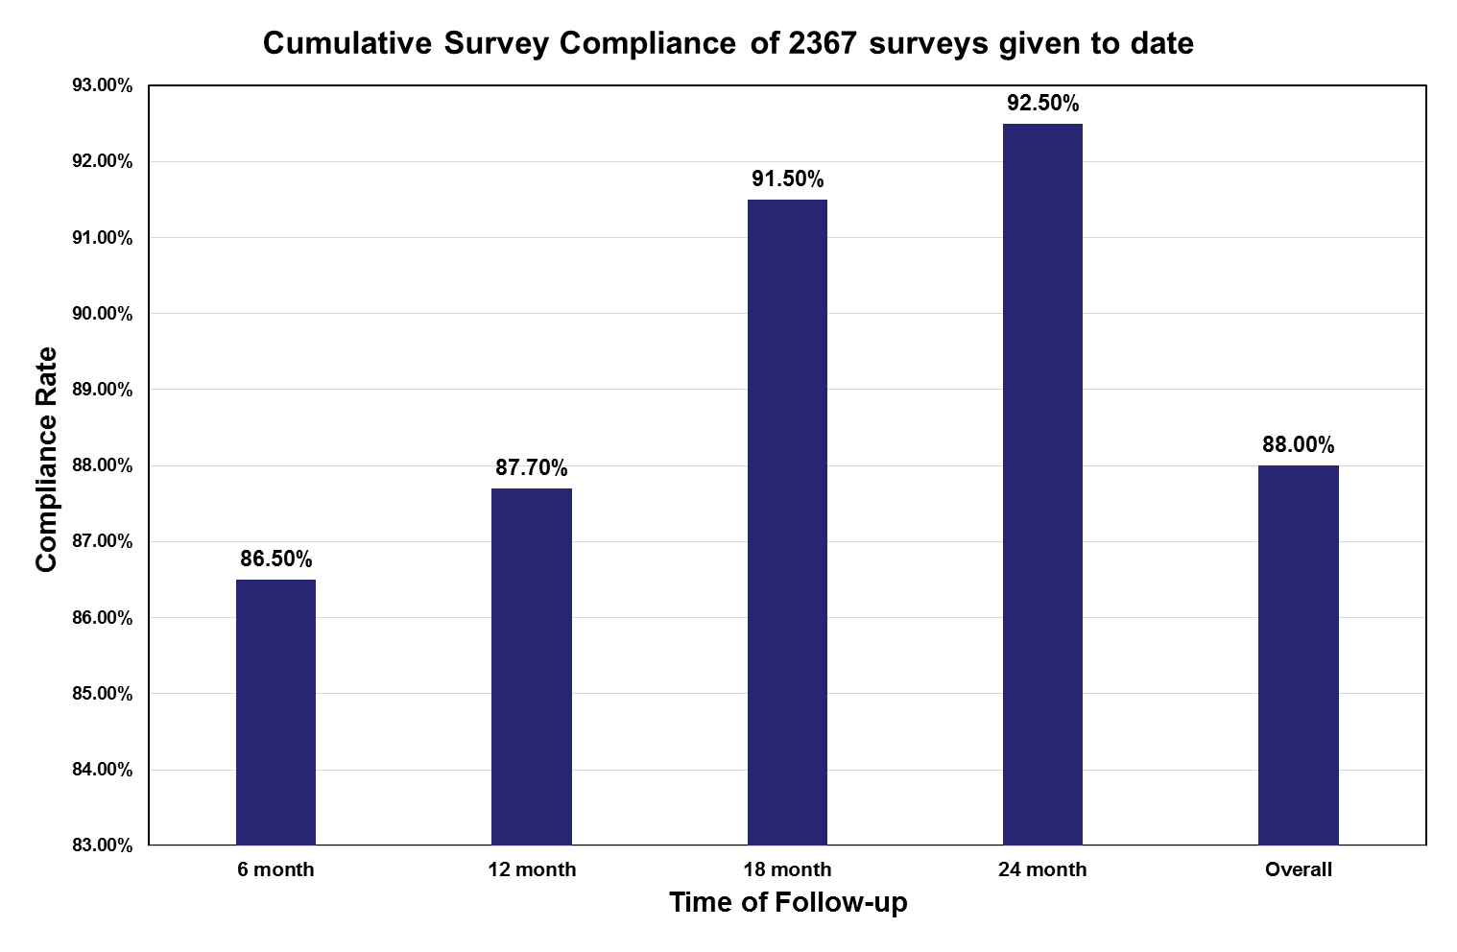
Survey Compliance

Slide 7
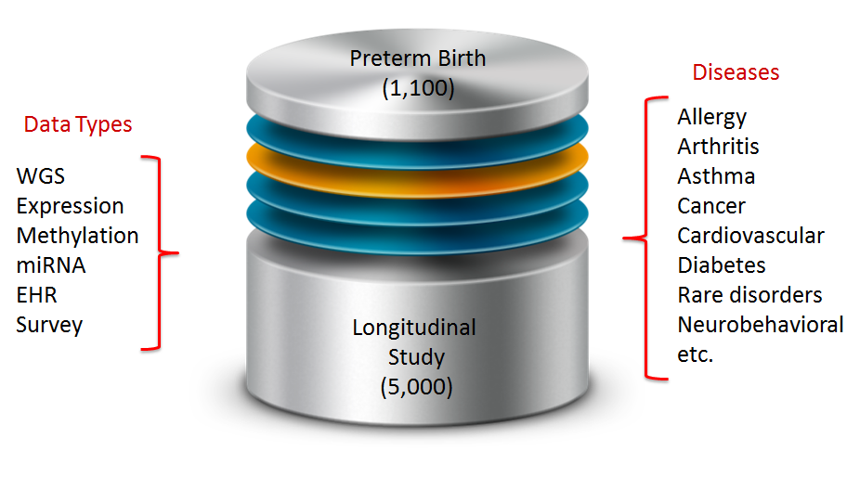
Background: ITMI Studies
Trio-based WGS
Expression, miRNA, Methylation, etc.
EHR + survey data
Aggregated database
Solomon, Molec Genet Genom Med 2014

Slide 8
A look at how the Inova ITMI study
“First Thousand Days of Life” evolved to the study of Environmental Influences on Child Health Outcomes (ECHO)

Slide 9
Data Overview
Participants
15,700 participants (enrolled), > 110 Different Countries of Birth
Files and data
Manage 3+ Petabytes of storage capacity (between cloud and on-premise)
Specimens
>450,000 specimens
Omic
7,300 + WGS
Molecular Data
Clinical
100,000+ Patient Diagnosis – ICD codes (Longitudinal)
4,000+ Variables from Surveys and Case Report forms
2,500,000+ Values from Case Report Form and Surveys
Lab
2,200,000+ discrete lab results
Clinical Variables

Slide 10
Biospecimen Collection (2018)
Blood | 2317
Placenta/CB | 254
Saliva | 1951
Urine | 1005
Meconium | 505
Total | Alot!

Slide 11
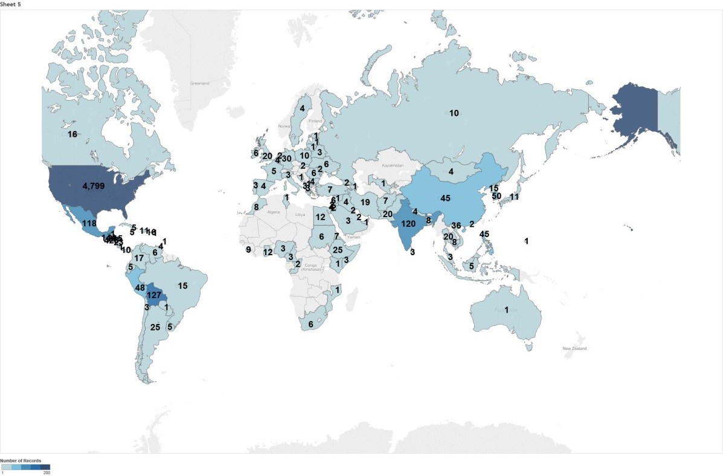
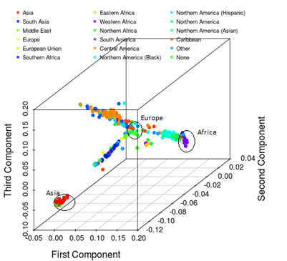
Cohort Diversity
104 countries of birth (parents)

Slide 12

Optimizing Identification of Disease
Causing Variants
Information
provided by sequencing companies
Common
Variants
Personal
Variants
Ancestral Reference
Genomes
Familial
Sequencing
Common
Variants
Ancestral
Variants
Familial
Variants
Personal
Variants
Probably Not Disease Causing Potentially Disease Causing

Slide 13


Broad range of early environmental exposures
Physical & Chemical
From
society
to
biology
Societal
Medical
Psychosocial
Behavioral
Biological
Health outcomes throughout childhood and adolescence
Conception
5 yrs
Notes:
EARLY ENVIRONMENTAL INFLUENCES:
Conception to age 5 years
BROAD RANGE OF INFLUENCES:
Society to biology
Physical and chemical
Societal factors—stress, maltreatment, etc.
Social factors—networks, SES, family dynamics, etc.
Medical factors—conditions, medications
Behavior—sleep, diet, etc.
Biology—epigenetics, microbiota, etc.

Slide 14
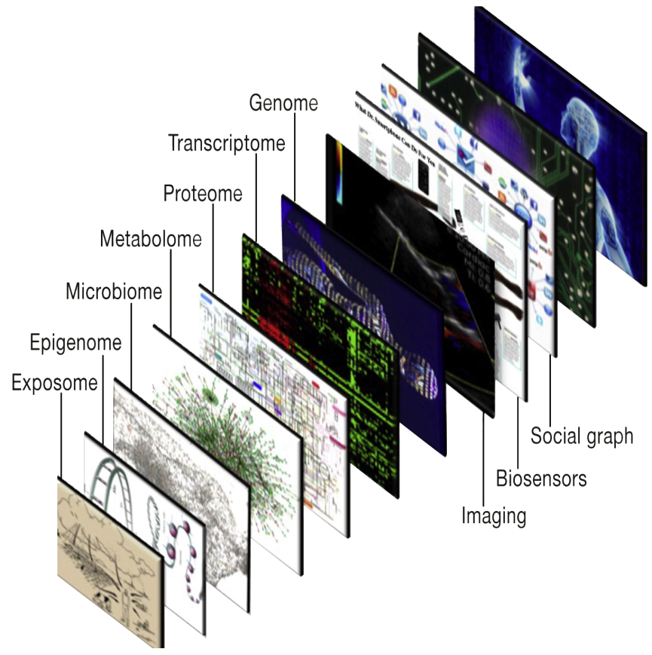


The ECHO-wide cohort Many people Many stages of life course Many layers of data
Topol 2014

Slide 15
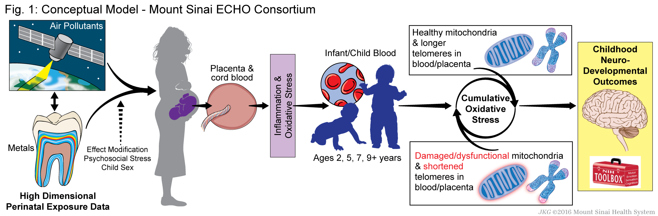
Perinatal Programming of Neurodevelopment

Slide 16

To enhance the health of children for generations to come
Notes:
Our nation’s children are waiting.
As we move forward, it is vital that we keep our mission in mind as we work toward achieving our ambitious but crucial goal of enhancing the health of children for generations to come.

Slide 17
Case Report Forms
Mother and Infant Specimen Collection
Events Comments
Follow Up
Continuation of Consent
Withdrawal
Mother Demographics
Mother Medical History
Surgical Procedures
Mother Social History
Mother Family History
Mother Life Events Evaluation
Pregnancy
Mother Labor and Delivery
Concomitant Medications
Father Questionnaire
Family Member Questionnaire
Father and Pertinent Family Member Medical History
Infant Birth
Infant Conditions

Slide 18
Mother’s Surveys

Slide 19
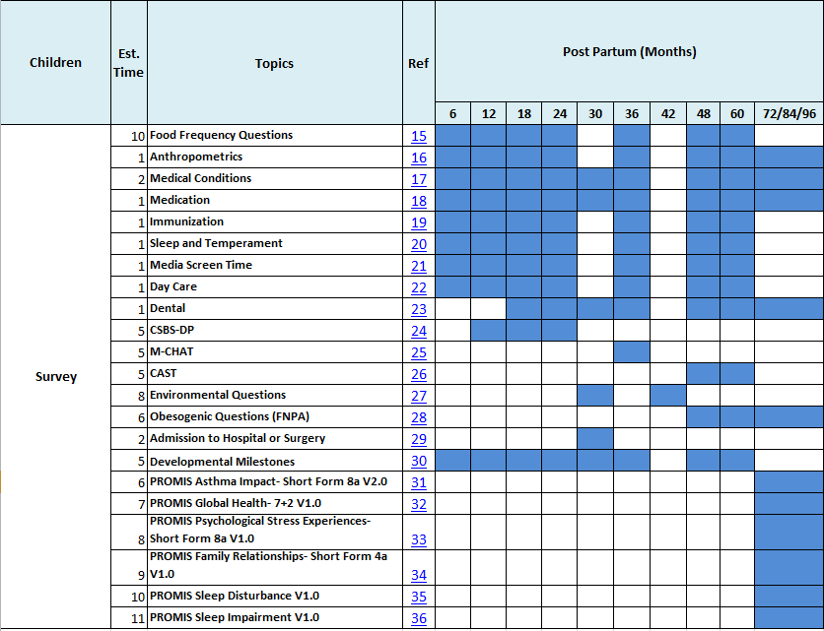
Child’s Surveys

Slide 20
Variables
CRFs ~ 500 variables
Surveys ~ 3500 variables

Slide 21
Data QA/QC
Warehouse level data QA/QC
Research level data QC
Internal and external validity
Congruence of self-reported data and measured data if possible
Data harmonization

Slide 22
Study Harmonization
102 & ECHO
ECHO WIDE
Other Grants, Collaborations, Sub Projects and Disease Cohorts
Obesity
Autism
Microbiome
Collective Analysis Studies
EC0xxx
Gestational Diabetes
Breast Milk and Maternal Confidence
ECHO PEDS
….

Slide 23
Epidemiological Projects
ECHO Collective Analysis Studies
Autism
Childhood obesity
Microbiome
Breast milk and maternal confidence
Evaluation of screen time in early childhood
Gestational diabetes
Preeclampsia
HPV
Congruence of self reported race/ethnicity and EHR data
etc

Slide 24
Time Varying Anthropometric Data

Slide 25
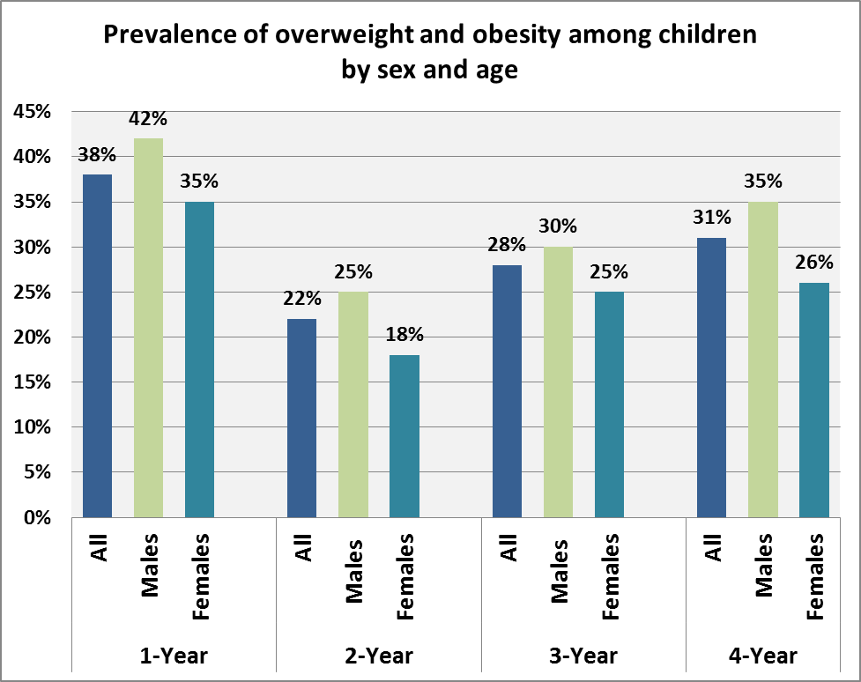
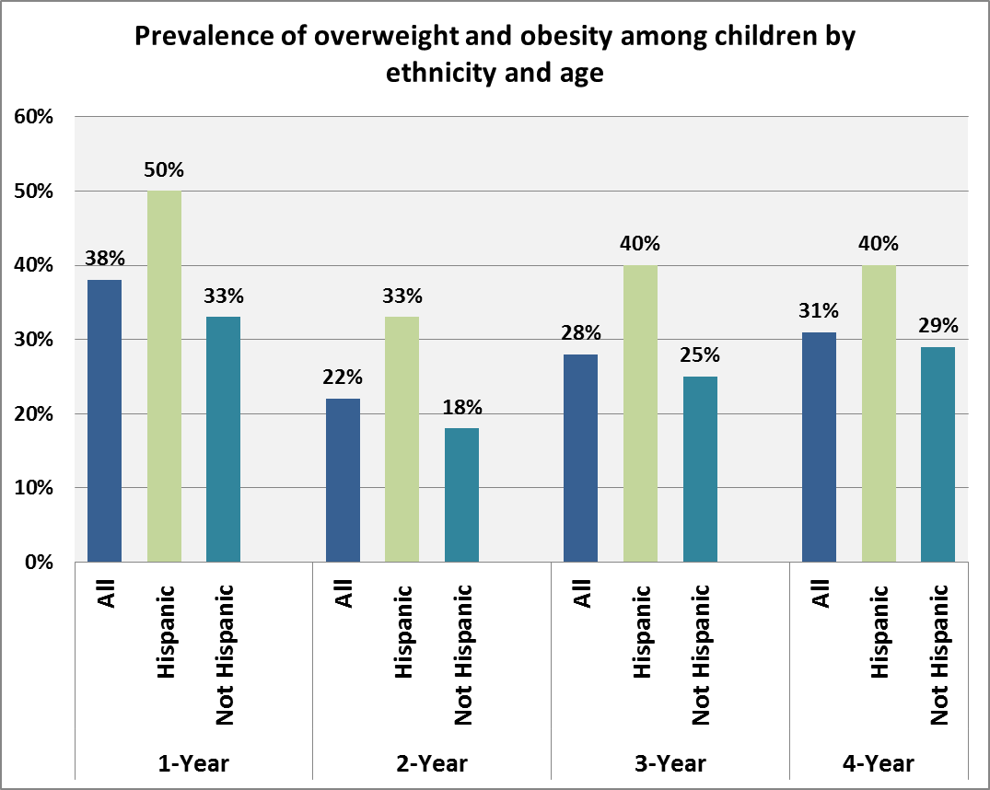
Prevalence of Childhood Obesity

Slide 26
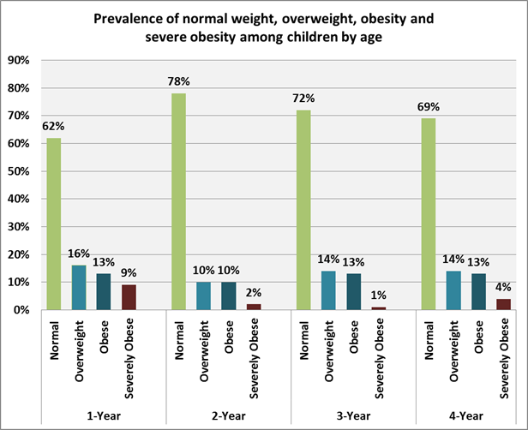
Prevalence of Childhood Obesity (Continued)

Slide 27
Autism Screening Tools
CSBS-DP at 12, 18 and 24 month
MCHAT at 36 month*
CAST at 48 and 60 month
* We missed Q14. Does your child respond to his/her name when you call?

Slide 28
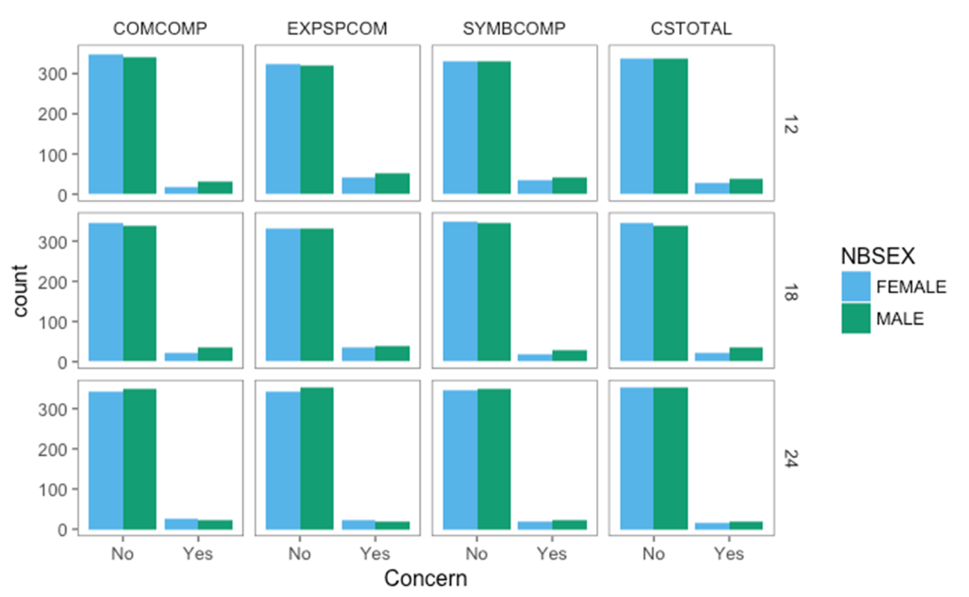
Communication and Symbolic Behavior Scales Developmental Profile for Infants and Toddlers Created

Slide 29
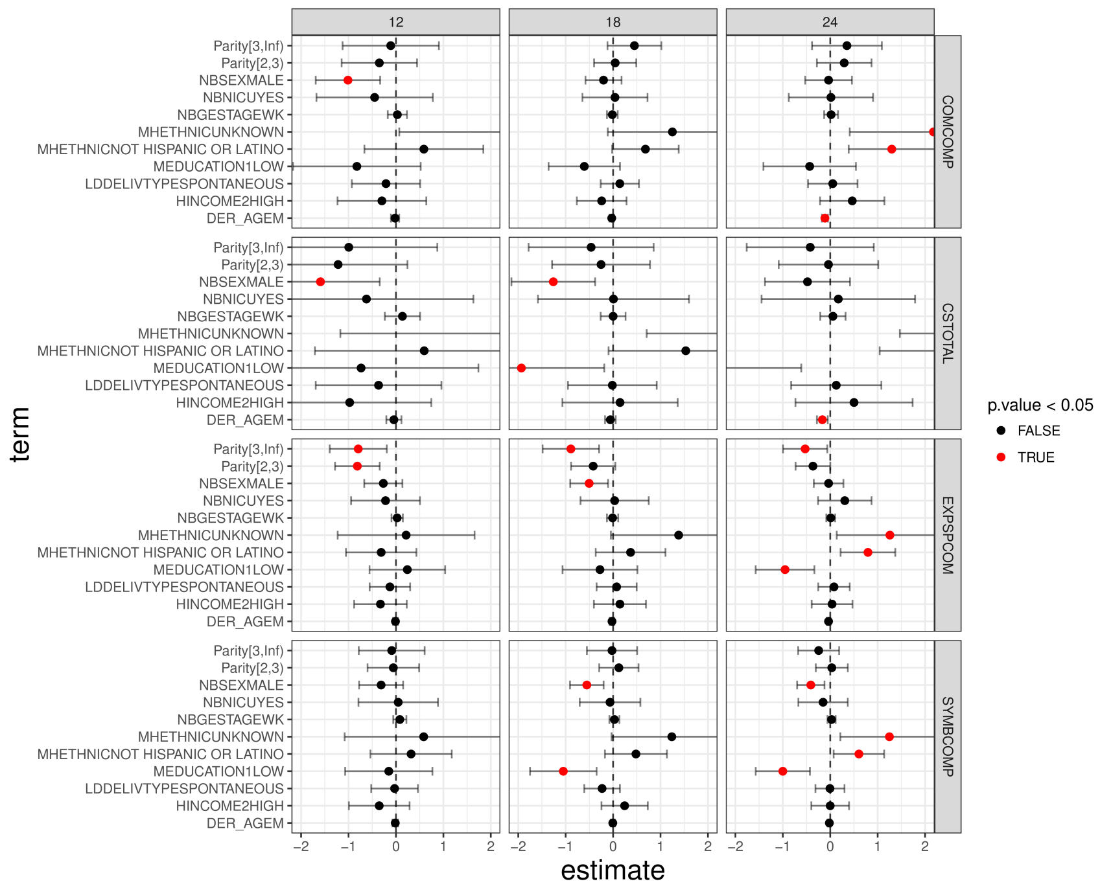
Summary of Regression Tests CSBS-DP Components

Slide 30


Slide 31
Completed Surveys:
6month = 2849
12month =2572
18 month =2206
24month = 1957
30month = 1409
36month =1120
42month =986
48 month = 691
60month = 189

Slide 32
Interesting Cohorts

